Slide 1
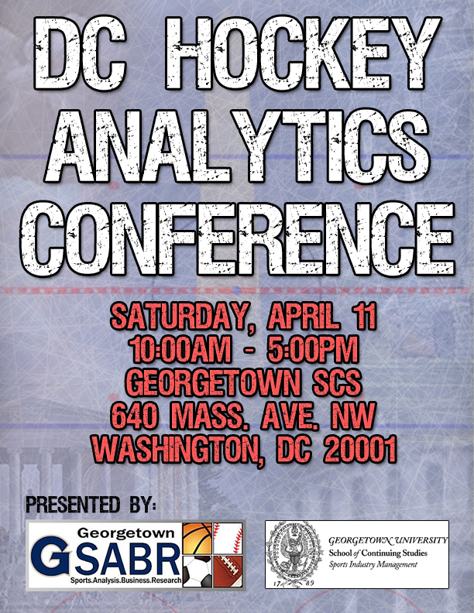
Notes:
Welcome to the DC Hockey Analytics Conference.
This is a project that has been months in the making, and I’m thrilled that you could all make it. I know that some of you will be taking off for the Caps game in a little while, and I want to encourage all of you to come back after the game, as we will be going here until 5 p.m., before heading over to Penn Quarter Sports Tavern to watch hockey for the evening. Our last presentation of the day, by WAR-On-Ice co-founder Sam Ventura, is one of the ones I’m most excited about, as he has been working on a legitimate version of baseball’s catch-all Wins Above Replacement statistic for hockey.

Slide 2
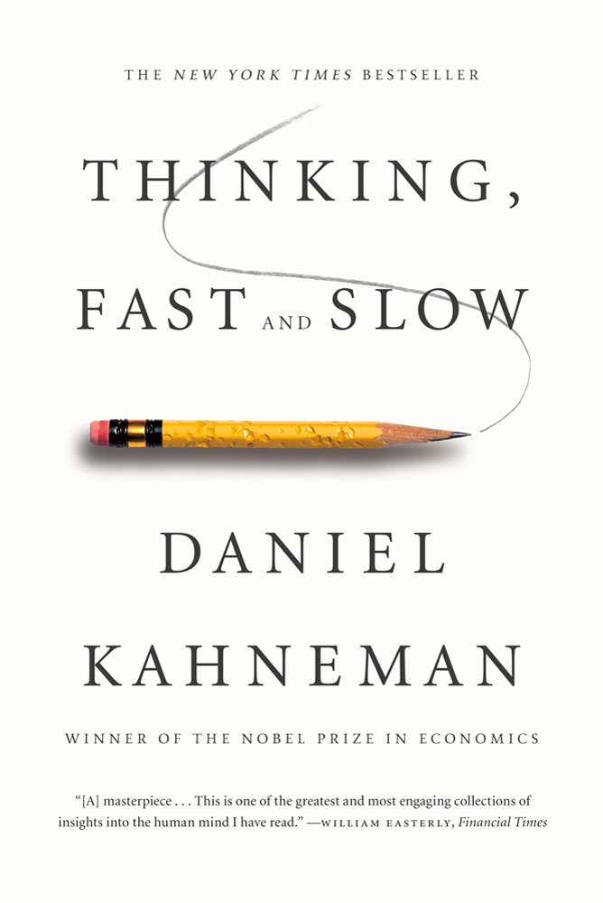

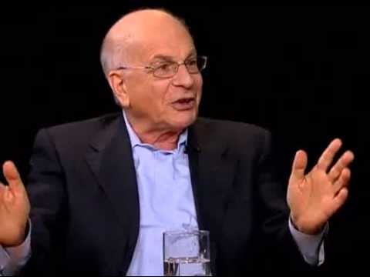
Notes:
I want to begin by addressing the question of “What are analytics,” or at least giving my interpretation, but before I do that, I want to talk about this (point to screen).
That, on the right, is Daniel Kahneman, and on the left is his 2011 New York-times best-selling book, Thinking, Fast and Slow. Kahneman is a Nobel-Prize winning psychologist, and an expert in behavioral economics. He won that Nobel Prize for something he discusses a lot in his book called “Prospect Theory,” which analyzes the way people choose between probabilistic alternatives that involve risk. Thinking, Fast and Slow is the key behind analytics.

Slide 3
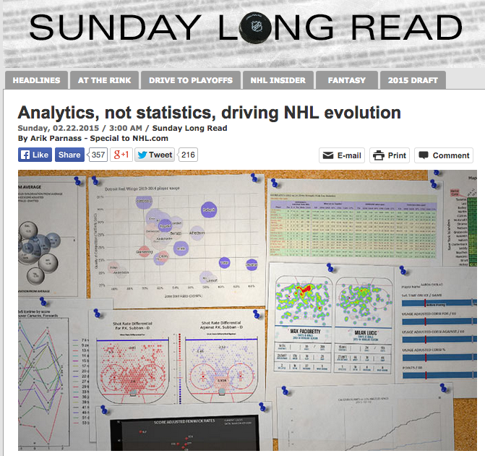
Notes:
Of course, we don’t all have time to read long books on behavioral economics, but contained within some of the recommended readings for this conference are some of the key points that Kahneman makes. This is my Sunday Long Read from last month on NHL.com. I wouldn’t normally self-promote, but my objective in writing this piece wasn’t just to get on NHL.com, it was to clarify the truth surrounding analytics and dispel a lot of the myths that allow fans, media, coaches, and executives to dismiss them. For the next 10 minutes or so, I want to bring up a couple of key tenants of analytics, both from Kahneman’s work echoed in my writing, because a basic understanding of analytics as a field is critical before trying to comprehend even the most basic of advanced or fancystats.

Slide 4
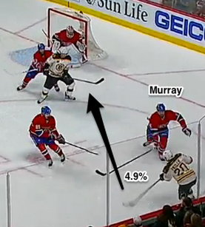
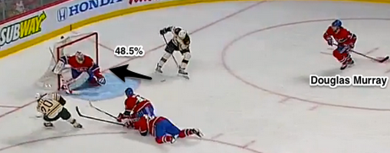
1. Hockey is a game of probabilities
“The ultimate test of an explanation is whether it would have made the event predictable in advance”
Notes:
These pictures represent probabilities of goals being scored on two very different shots. The images are from an article I published last Spring on Michel Therrien’s decision to bench Douglas Murray for Nathan Beaulieu. The actual numbers are made up, but for the purpose of the exercise that doesn’t matter. Every shot has a set probability of going in the net from the time that it’s taken. Even a dump out of the zone and into the other team’s end has something like a 0.000000000001 percent chance of winding up as a goal, as Vesa Toskala knows all too well. We can’t possibly ever know what these exact percentages are, but we do our best to estimate them, even without realizing it. We know that a Stamkos one-timer from the slot has a better chance of going in than a Tim Gleason unscreened wrister from the point. Our mind generates these odds for us, but obviously in very general terms. But there are two problems with this. One is that, as Kahneman would say, our mind lies to us constantly, especially when it’s on auto-drive. The second and more important problem is our need to assign causality to everything. “We understand sentences by trying to make them true,” he writes. “When we detect what appears to be a rule, we quickly reject the idea that the process is truly random.” The next time you watch a hockey game, think about the number of times a seemingly harmless shot from the point with a crowd of bodies in front could have found its way into the net. Often the goalie has no idea where the puck is, and reacts only once he hears it harmlessly hit the boards. In Wednesday’s critical game between the Capitals and the Bruins, I counted five such occasions. The Capitals won the game 3-0. Because of that, the Bruins may miss the playoffs. They may fire their coach and general manager. They may win the draft lottery. Bounces like these affect every hockey game, and luck tends to manifest itself in unintuitively large clusters, as seen with the success even over the course of entire seasons by teams like The 2013-14 Colorado Avalanche, who have since fallen back to earth. And yet commentators continually assign causality as an absolute. Humans are terrible at understanding luck or variance, and it scares us to consider how big of a part it really plays in our lives. We’d rather feel in control, in a world that is entirely deterministic. But as Kahneman writes, “the ultimate test of an explanation is whether it would have made the event predictable in advance.” Sidney Crosby missing an entire series due to injury would have made the Penguins losing a playoff series largely predictable in advance. A particular screen and shot at the net from the half-boards by a fourth liner, as seen in the picture above, probably not.

Slide 5

2. The eye-test is flawed
“We can be blind to the obvious, and we are also blind to our blindness.”
Notes:
I want you all to watch the following video, follow the instructions, as it will ask you to count the number of passes of the ball by people wearing white, which as it turns out is a surprisingly hard task. If you’ve seen the video already, obviously don’t spoil it.
[Play video]
Billy Beane, the renowned GM of the Oakland A’s, once said regarding the eye test, “the idea that I trust my eyes more than the stats, I don’t buy that because I’ve seen magicians pull rabbits out of hats and I just know that rabbit’s not in there.” It’s easy to say that you watch the games and therefore you know hockey, but our mind is incredibly bad at retaining information, especially for a sport with as much going on as hockey. As Kahneman points out about that video, the most remarkable observation is that people find its results surprising. As he writes, “the gorilla study illustrates two important facts about our minds: we can be blind to the obvious, and we are also blind to our blindness.” Keep that in mind next time you hear a scout discuss a player they’ve only seen a handful of times, without the support of objective statistics.

Slide 6
So What are analytics?
“Increasing knowledge (prediction power) using data & analysis” – Daryl Morey, Houston Rockets GM
“It’s using all available resources (data, video, scouting, etc. in concert to reduce the gap between potential and reality in sports performance, at the team and individual level.” – Neil Greenberg, Washington Post
“Analytics is about both asking questions and finding answers. For me, it is about how my brain is wired. I’m constantly asking questions like “why?” and “how?” and “what would work better?”. It is a way of life more than it is a job.” – Sandy Weil, Baltimore Ravens Director of Football Analytics
“Hockey analytics are just the objective analysis of hockey.” – Rob Vollman, Hockey Abstract
My take: “Analytics are the study of data to find meaning, while using all tools available to scrutinize decision-making.”
Notes:
Jonathan Gordon of Sports Analytics Blog put together a great list of definitions of analytics from people in the industry, and I’ve taken a few of those, and added Rob as well as my own take here.
[Read the definitions].

Slide 7
New Hockey stats
Corsi/SAT: On-ice shot attempt differential, for a player or team, can be expressed as a +/- or a %.
Ex. Alex Ovechkin had a CF% of 39% on Wednesday night.
Fenwick/USAT: Like Corsi but doesn’t include blocked shots
Ex. The Washington Capitals have a 52.1% FF% this season.
PDO/SPSV%: On-ice shooting percentage plus on-ice save percentage, a proxy for luck
Ex. The New York Rangers have a league-high PDO of 102.
Notes:
The idea behind the wave of new statistics in hockey, at least the basic ones, is that there is a ridiculously large amount of variability inherent in the process of shooting. Shooting in itself is a very streaky process, and then you add goaltending to the mix, and it is very difficult to evaluate what aspect of a player or team’s shooting success is true talent and what portion is luck. Because of that, shot differentials, and in this case shot attempt differentials, because of a much larger sample size, correlate decently well with future goals.
We tend to track these stats at 5v5 because it creates an even playing field, and teams get different amounts of power play and penalty kill time. We also generally score adjust these stats, because of score effects, which you’ll hear more about later.

Slide 8
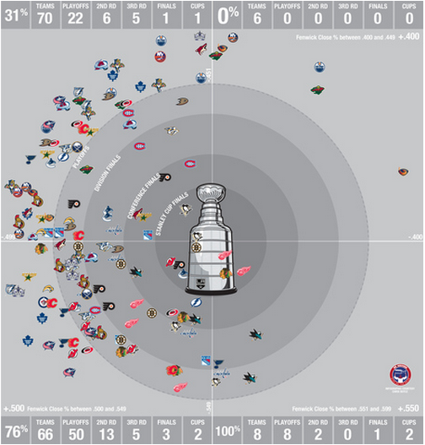
“Analytical types like Corsi. Why? We care not for shots over goals, but future goals over past goals.” – Garret Hohl
Notes:
This is from Chris Boyle at HEOTP back in 2013. Teams in bottom half of picture have Fenwick Close (explain that) above 50%, teams at the top are below 50%. The bottom right quadrant specifically is the rare team above 55%, and the top right is teams below 40%. It’s not hard to tell from this graph that there’s a clear connection between shot attempt differentials and success. The ’08 Penguins were the only team with a sub-50% shot differentials to make the Stanley Cup finals, and Fleury for once was spectacular in the playoffs that year.
[Click]
Ultimately, these factors are important because generating shots tends to be a more easily perceptible and repeatable skill than finishing those chances on offense or keeping the chances to the outside on defense. So it’s not that we’re favoring shots over goals, it’s that we favor future goals over past goals, because unless it’s mid-July, it is future goals that will decide the Stanley Cup. And if it is mid-July, then it’s future goals that will decide next season’s results.

Slide 9
New hockey stats
Offensive Zone Starts (OZS):
Proxy for the percentage of shifts a player starts in the offensive zone rather than the defensive zone.
Quality of Competition (QoC):
Either based on Corsi or Time On Ice
Quality of Teammates (QoT):
Either based on Corsi or Time On Ice
Notes:
These are three of the more common contextual stats that are important to use in conjunction with shot attempts stats.
[Explain the stats]
It turns out, understandably so, that QoT is more important because while the distribution of players somebody will face over the course of the season is vast, that’s not necessarily the case for QoT, so the latter can have a bigger impact

Slide 10
DCHAC guidelines
If you have questions at any point for our presenters, whether here or following along on the web, use #DCHACQ
Be sure to make use of our breakout rooms during breaks, as our presenters each have an assigned room on your programs
Feel free to take pictures, and your feedback is encouraged
Donation box at the front
Enjoy!

