Slide 1
Closing comments
Playoffs are coming
Notes:
So I want to conclude with some of the open questions in analytics that I’ve heard from team and league executives in different sports, and just that I believe require further research.

Slide 2

HomeSick?
Team | Gms | SCF/60
T.B. | 63 | 31.19
NYR | 18 | 21.43
Team | Gms | G/60 | A/60 | P/60 | CF/60 | Sh% | OSh%
T.B. | 63 | 1.04 | 1.16 | 2.20 | 56.83 | 13.93 | 10.08
NYR | 18 | 0.00 | 0.97 | 0.97 | 55.29 | 0.00 | 6.20
Notes:
This is Martin St. Louis. Last season at the deadline he was traded from the Tampa Bay Lightning to the New York Rangers. Prior to the trade, he was one of the top scoring players in the National Hockey League, but following the trade he appeared to struggle. By the eye-test, he didn’t look entirely comfortable, wasn’t driving the net, things like that. So let’s look into his numbers. You can see that his on-ice shot attempts for stayed relatively steady, and yet his shooting percentage plummeted. So the question becomes, was this a streak of bad luck? Or was St. Louis just having a hard time adapting to a new environment? Or could both be true? This is an issue that plagues front offices in all sports. It’s something that baseball especially, a sport in which teams now openly employ analytics, struggle with. How do you separate a change due to causal factors with one simply caused by luck? How do you know if you need to change anything, or if your luck will simply turn around?

Slide 3
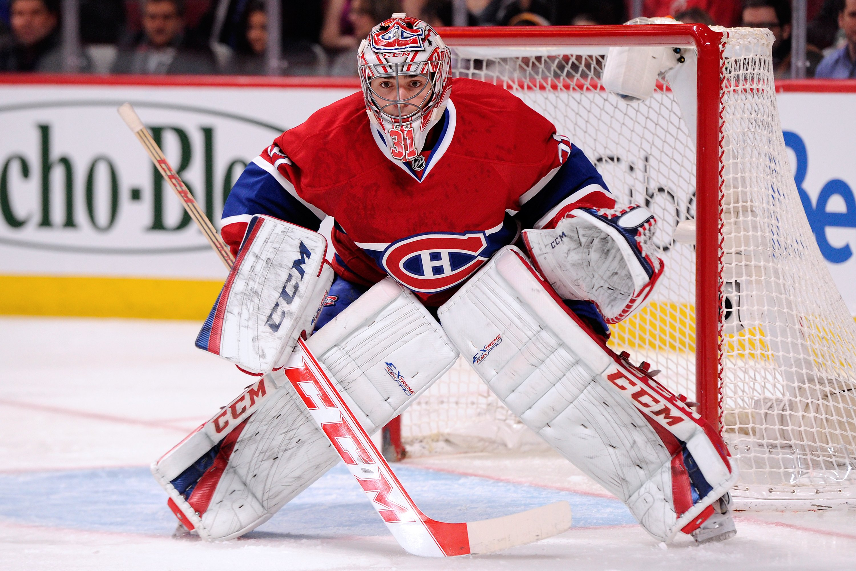
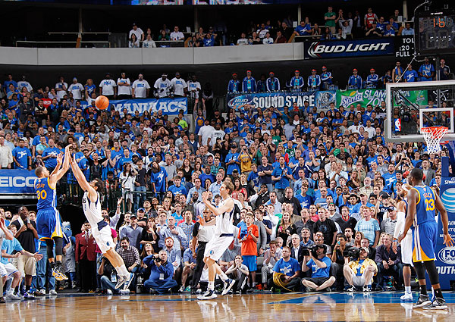
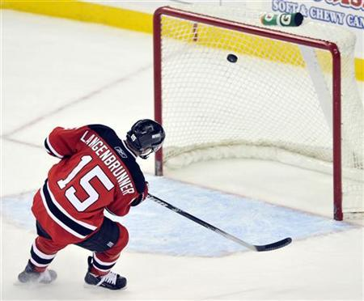
Comparison offshoot
Notes:
The second big issue, relating more directly to hockey, that I see right now is dealing with the confounding factor that is goaltending. To understand this factor, let’s compare hockey ot basketball. In basketball, it’s quite easy to get a sense for what are high quality and low quality shots, or who is a good and bad shooter, fairly quickly, because the net doesn’t move, and there’s nobody distinctly guarding it. In order to get a sense for a player’s true shooting ability in basketball, you simply need to get a large enough sample size to filter out one variance factor.
In hockey, though, the goalie complicates things. If a shooter were to shoot 100 shots at a crossbar of an empty net, they might hit it 40 times on average. There’s variance in that distribution similar to what you see when an NBA player shoots three-pointers. Now if you had a goalie face 100 shots from an automatic shooting machine shooting at different parts of the net with no shooting variance, the goalie might save 90 of them, but there would be variance in the distribution there as well. When you divide the variance inherent in a player’s shooting ability by the goalie’s ability to make saves, you end up with compounding variance, which is why the sample size needs to get so large before you can make any reliable claims about a player’s shooting ability or a goalie’s saving ability. Bill James would call this a comparison offshoot.
The big problem with this, even beyond the obvious, is that players change. They get better or they age, or they make technical tweaks, and often your sample size gets washed out by the time you have it because of changing environments. We need to find a way to more reliably assess these skills faster, and hopefully tracking data will provide that

Slide 4
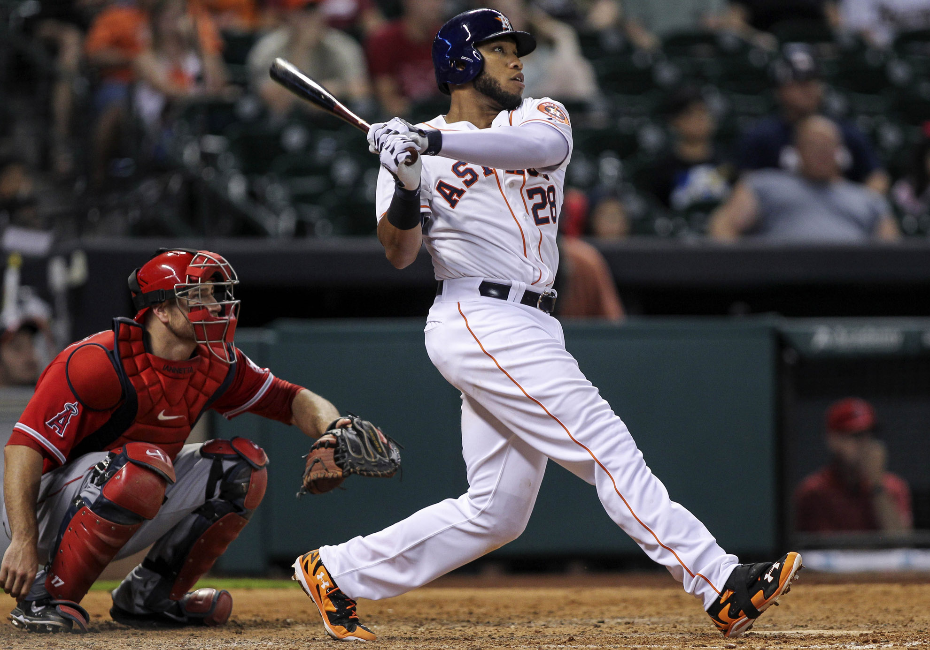
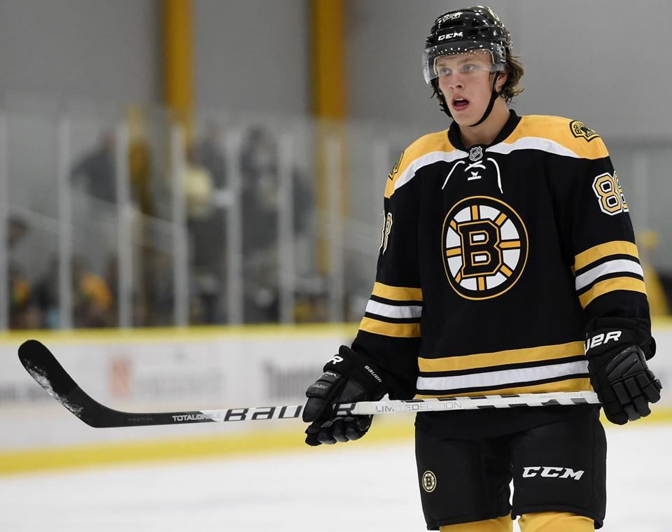
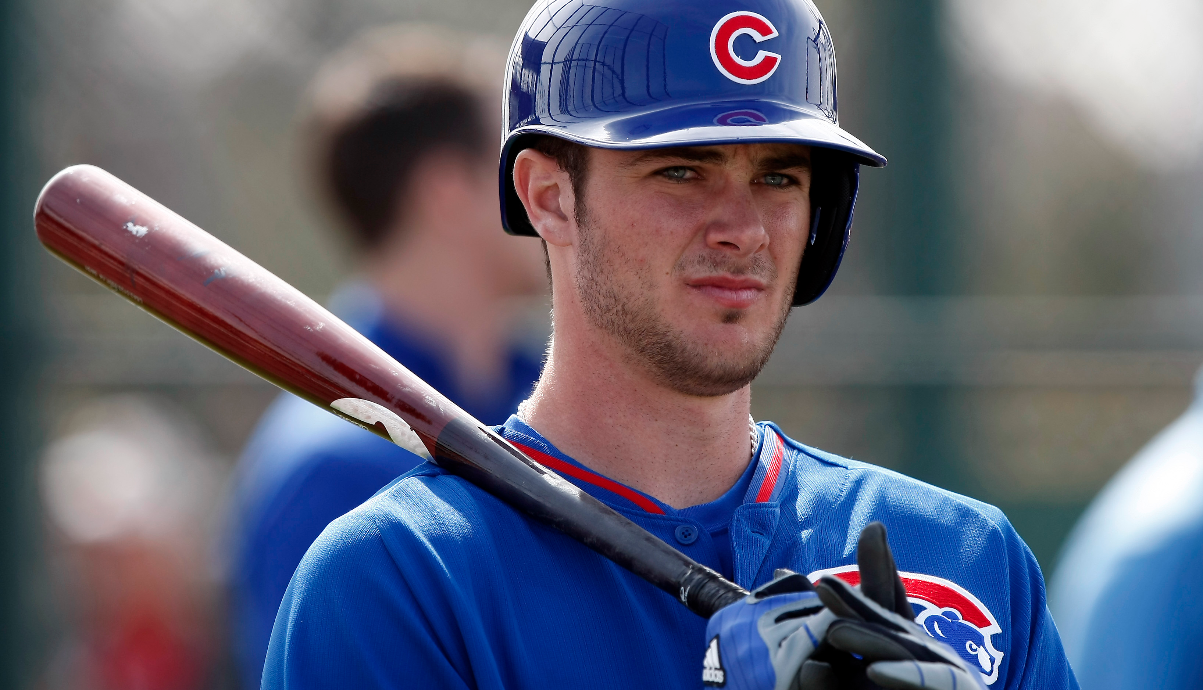
Notes:
This is Jon Singleton, a promising player who the Houston Astros signed last year to a 5 year, $10 million dollar contract while he was still in the minor leagues. It was a controversial contract because, at least in the view of many, the Astros refused to promote Singleton unless he signed, so that they could retain team control of him.
(Explain Kris Bryant and David Pastrnak)
The Astros are an example of a professional sports franchise that has gone all in on analytics. They were ranked no. 2 on ESPN’s Great Analytics Rankings, behind only the Sixers, and it’s clear that they have been making decisions for a number of years now with the idea of maximizing total output above all else. The problem is that sports are a few others, since your commodity is essentially people.
So former Astros pitcher Bud Norris had this to say following a trade:
“They are definitely the outcast of major league baseball right now, and it’s kind of frustrating for everyone else to have to watch it. When you talk to agents, when you talk to other players and you talk amongst the league, yeah, there’s going to be some opinions about it, and they’re not always pretty.”
A current Astros player, anonymously, had this to say:
“I don’t think anybody’s happy. I’m not. They just take the human element of baseball. It’s hard to play for a GM that just sees you as a number instead of a person. Jeff is experimenting with all of us.”
So the question becomes, how can you optimize your business practices and your output as an organization, without your players feeling like nothing more than commodities?

Slide 5
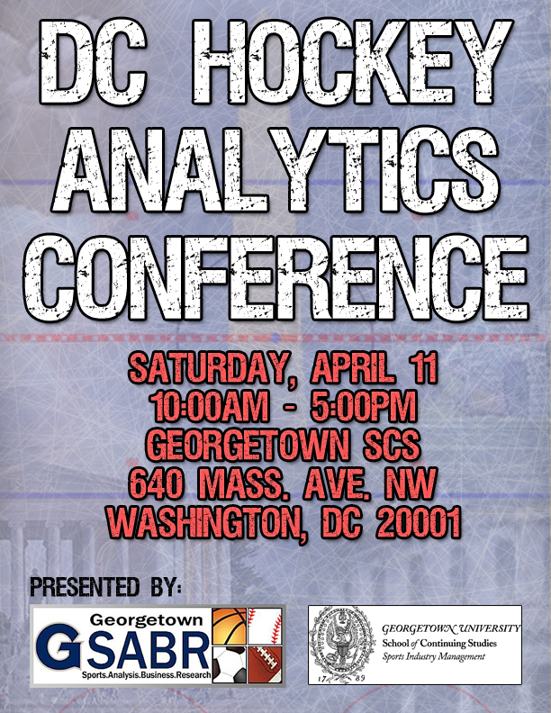
Notes:
Before we go I need to make a few thank yous.
I want to thank Sam Yarin and the staff here at the Georgetown School of Continuing Studies.
I want to thank the Georgetown Sports Analysis Business Research group for helping out.
I want to thank Rob Vollman and everybody else with whom I consulted about this, and who helped to spread the word.
Thanks to all our awesome speakers and panelists today.
Thanks to Robb Tufts who got all the great breakfast and refreshments, and who was really the one who inspired me to make this happen on the way back from Pittsburgh.
And thank you all so much for coming and being a part of this.
I want to remind you all to go check out the previous three speakers in our breakout rooms now, and that we will be heading to Penn Quarter Sports Tavern soon as well for some hockey watching tonight.

