Slide 1
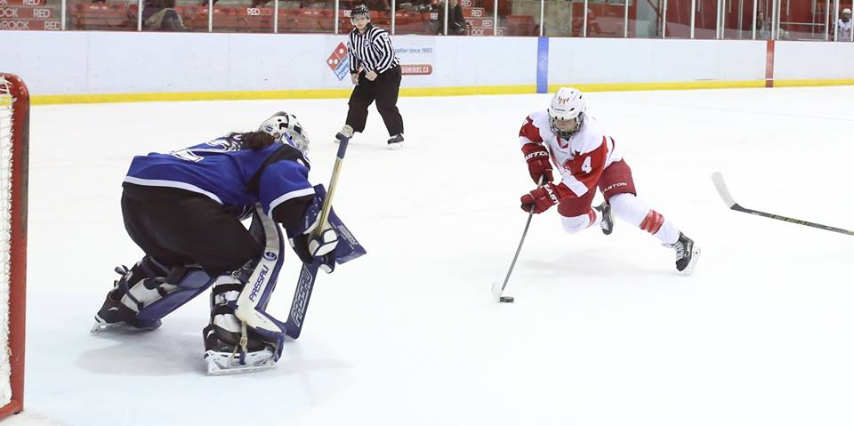
Birds of a feather
Implementing analytics @ the mcgill martlet hockey program
@ML_Han / Photo credit: Derek Drummond

Slide 2
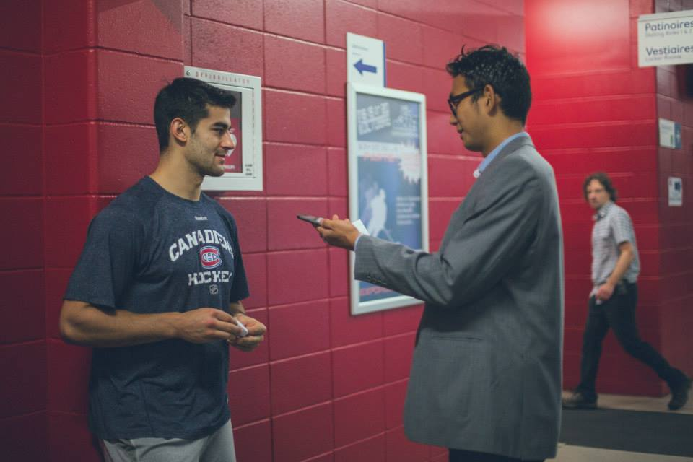
About me
McGill BCom 2011 (Marketing/Political Science/German)
Works in marketing & communications for tech startups
Coached/played hockey at high school level
Covered ATP/Davis Cup tennis from 2009 to 2013
Social media and web contents for the Montreal Canadiens, 2013-14 NHL season
@ML_Han / Photo credit: Florence Labelle

Slide 3
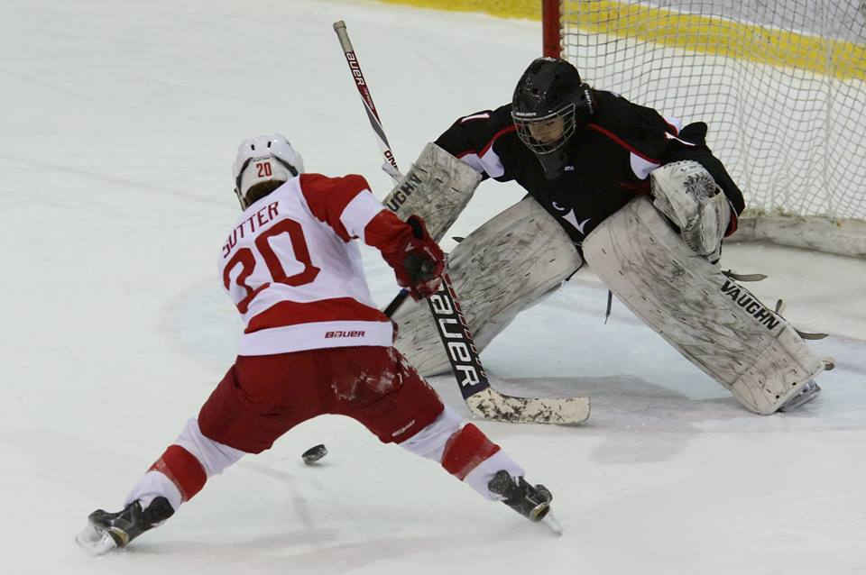
Why analytics
“The product is on the ice.”
  Product trumps marketing
In sports, analytics is useful because
  1) They allow us to optimize outcomes (more wins)
  2) They help us appreciate athletes we may otherwise overlook
  3) They bring more people into the game
@ML_Han / Photo credit: Derek Drummond

Slide 4
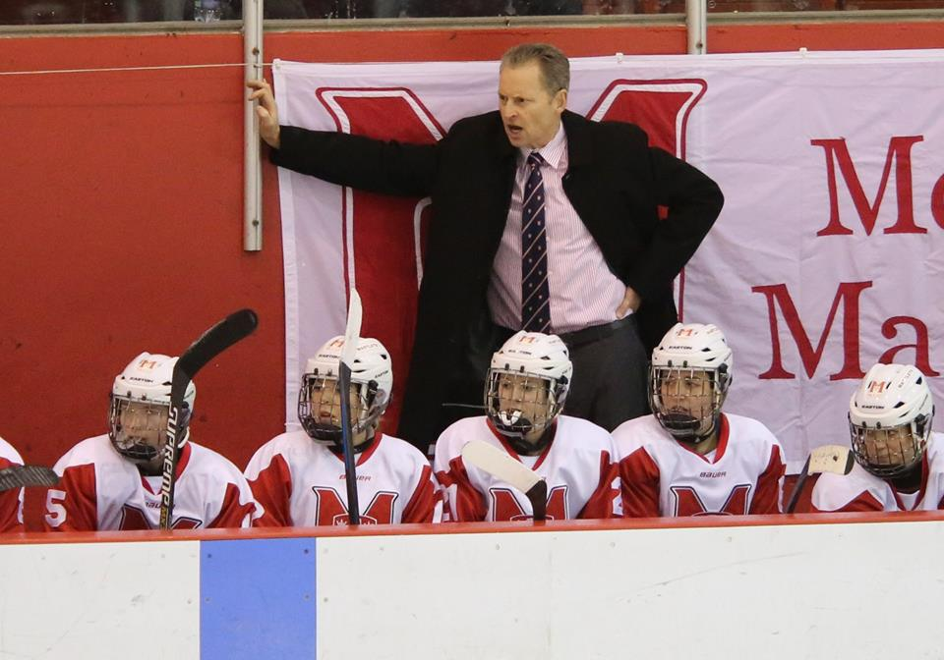
Why McGill Martlets
The Coaching Staff
  Peter Smith : Olympic gold medalist, CIS national champion, Team Canada head coach
  Professional, progressive, people-oriented
The Game
  Women’s hockey fit the platonic ideals of possession hockey
  A different proving ground to test and refine analytic theory developed for the NHL
The Institution
  Analytics as a teaching tool: fulfilling the mission of higher education
  Putting student-athletes in the best position to succeed
@ML_Han / Photo credit: Derek Drummond

Slide 5
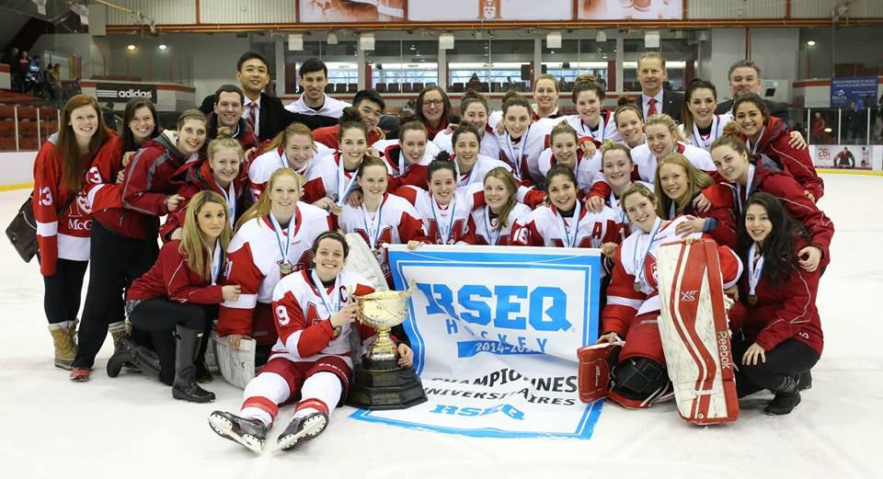
The 2014-15 team
Offense:
  4.25 GF/Game (#2 in Canada – 33 total teams in CIS)
  40.4 Shots/Game (#1)
  19.8% powerplay conversion (#5)
Defense:
  2.09 GA/Game (#13)
  16.3 Shots Allowed/Game (#1)
  88.6% penalty kill (#19)
RSEQ Provincial champions
CIS National Championship runners-up
@ML_Han / Photo credit: Derek Drummond

Slide 6
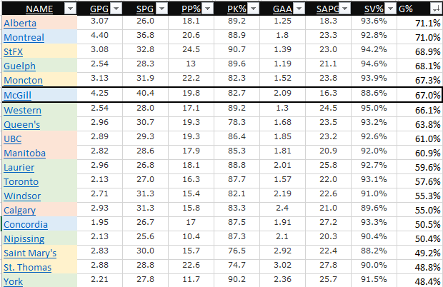
@ML_Han

Slide 7
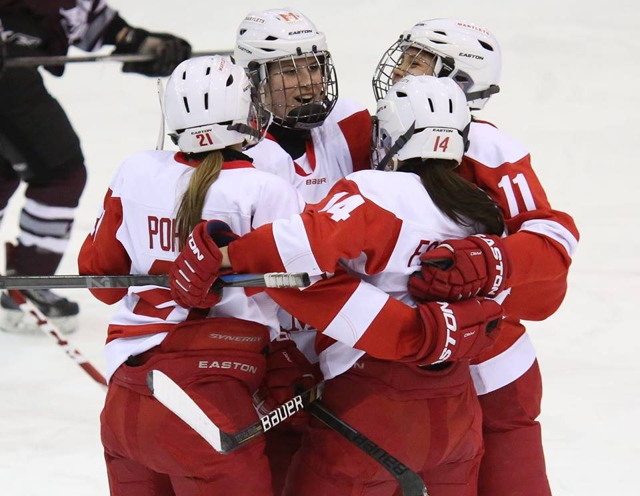
4 pillars of analytics implementation
1) IT Framework
  Hardware + software + storage
2) Data collection
  Who/when/where/how reliable
3) Analysis and interpretation
  “Fancystats”
4) Presentation and communication
  Turning insights into action
+ “The Golden Rule”
@ML_Han / Photo credit: Derek Drummond

Slide 8
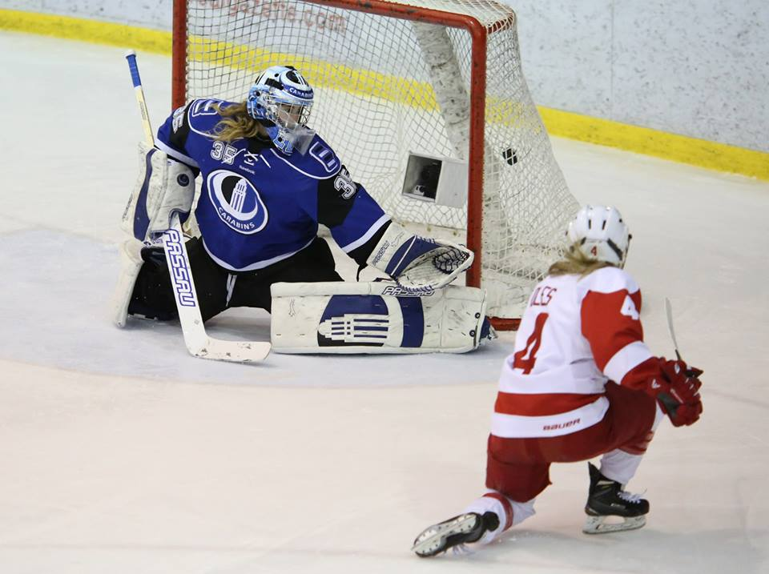
Plans for the future
Losing is a great motivator.
IT improvements
  Video & data storage
  Video sharing
Shot Quality tracking
  Can we manipulate shot% and save%?
  Our PDO was under 100 last year. Can we do better? It’d be irresponsible not to try.
(Trying to) find a way to replace our 5th year Seniors
  “How would the Blackhawks replace Kane, Toews & Keith?”
@ML_Han / Photo credit: Derek Drummond

Slide 9
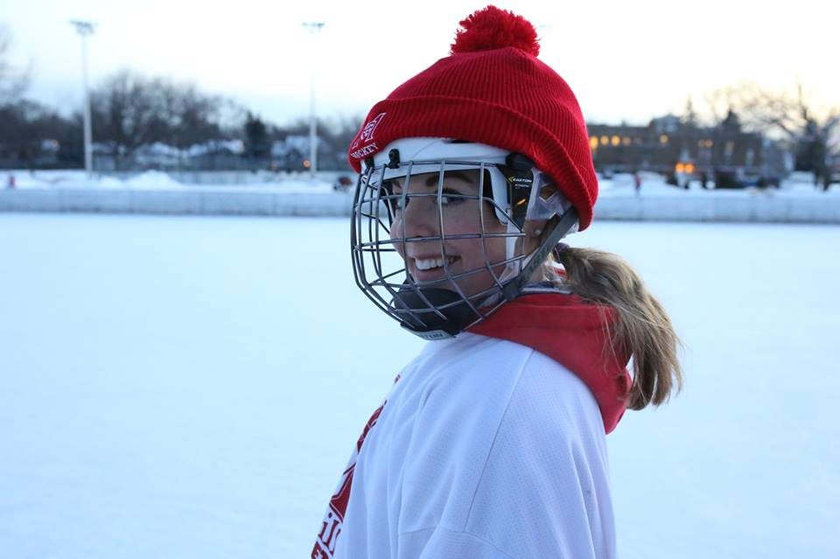
Final thoughts
…about the eye test
…about PDO and luck vs. skill
…about why people should care about women’s hockey
@ML_Han / Photo credit: Derek Drummond

Slide 10
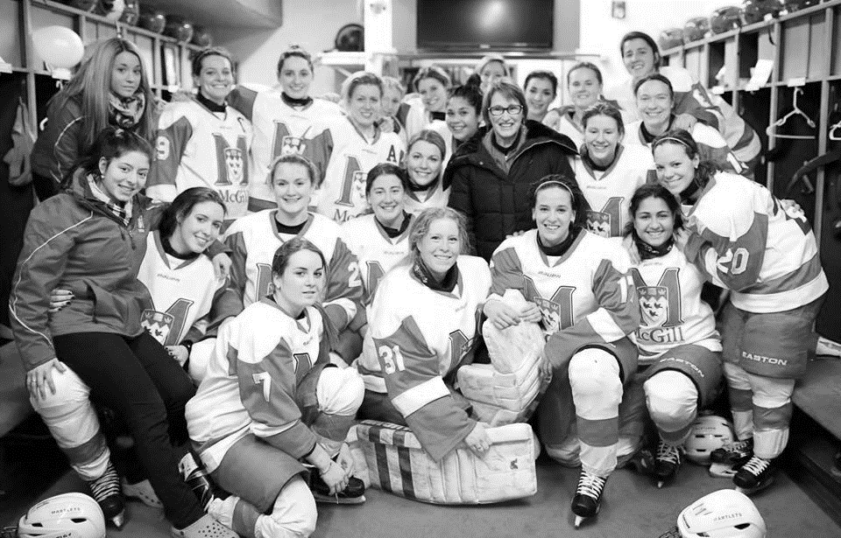
Thank you!

